Slide 1
SPSD Training For New Staff C Practice 2
Cheng Wei, SPSD
June 6, 2021

Slide 2
Content
Array
Pointer
Structure
Stack and Heap

Slide 3
Array
Declaration
Initialization
Length & Size
Access
Multiple Array
Notes:
In software development, integration is the process of incorporating changes like refactored code, new features, or bug fixes into the existing codebase.

Slide 4

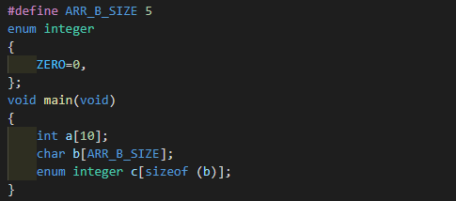
Array
What Is Array?
An array is a set which has multiple values with the same type and which has same meaning. The values of array store sequentially in memory, without any space between each other.
Declaration
format:
type can be either built-in data type or customized structure, union, enumerate and so on.
length better to be constant, not a variant, even though C99 has supported for variant array.
for example:
Notes:
A deployment pipeline is an automated system that runs increasingly rigorous test suites against a build as a series of sequential stages.

Slide 5
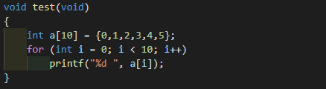
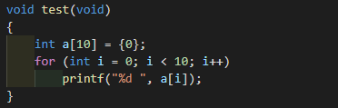
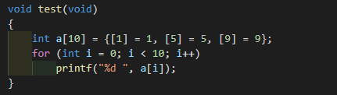
Array
Initialization
partial initialize:
output: 0 1 2 3 4 5 0 0 0 0
all to zero:
output: 0 0 0 0 0 0 0 0 0 0
specify initialize:
output: 0 1 0 0 0 5 0 0 0 9 tip: C++ don’t support specify initialization

Slide 6
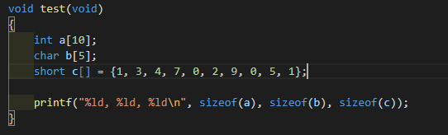
Array
Length
In ordinary situation, we declare a dedicated length array, it’s easy to get the length, but we may declare and initialize an array without length likes:
int a[] = { 1, 3, 4, 7, 0, 2, 9, 0, 5, 1};
How to get the length of a?
Size
Size of an array not means the array length, but the memory occupy size, it is equal to the element size multiplied by the array length. We commonly use the key word “sizeof“ to get the array size.
output: 40, 5, 20
Back to the problem, we can easily get the total size , how about element size? Easy too, it is sizeof(element[0]), so we can get the length of array c by the code: sizeof(c)/sizeof(c[0])
Notes:
A deployment pipeline is an automated system that runs increasingly rigorous test suites against a build as a series of sequential stages.

Slide 7
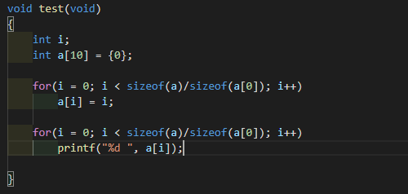
Array
Access
Index is used to access the element in an array which is started from 0.
Max valid index is the array length – 1, access exceed length – 1 has non sense and may cause unknown error.
“for” or “while” loop is used to access each element.
Notes:
A deployment pipeline is an automated system that runs increasingly rigorous test suites against a build as a series of sequential stages.

Slide 8

Array
Multiple Array
Initialization:
Storage in memory:

Slide 9
Pointer
What is Pointer
Pointer variable
Pointer calculation
Pointer and array
Pointer and function

Slide 10
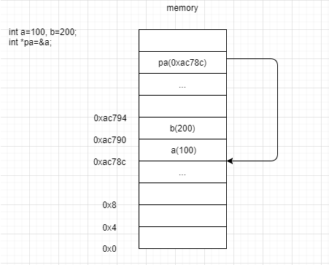
Pointer
What is pointer
Simply speaking, pointer is memory address. Codes run in memory, variants and functions are all stored in memory in their life cycle, we can access them through their name, pointer is another way to access to them.

Slide 11
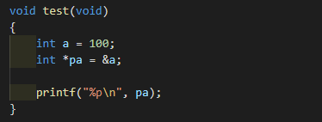

Pointer
Pointer variable
Pointer variable is used to store pointer, its value point to a memory address.
Declaration format: type *pointer_varrint;
Type can be any valid data type, int, float, double, struct xxxx, and so on
Example:
output: 0x7ffc6c25d22c
Multiple pointer variable declare in one line, each variable need * :

Slide 12
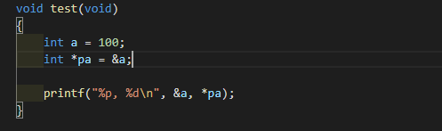
Pointer
Pointer variable
NULL is defined to 0 and when pointer value is NULL it means invalid in most operation system, but in embedded software, 0 just means an address, it may be meaningful, be careful.
Void * means do not known the value type of the pointer, it cannot be used to do math calculation.
& is used to get pointer of a variable , * is used to get the value what the pointer(address) stores.
Output: 0x7ffc6c25d22c, 100

Slide 13
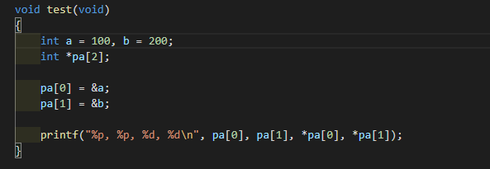
Pointer
Pointer variant
Pointer to a pointer is the same with pointer to ordinary type, the difference is the content stored in the memory is a pointer variable.
Pointer array is the same with ordinary array, the difference is each element of the array is a pointer.
output: 0x7ffc3437b038, 0x7ffc3437b03c, 100, 200

Slide 14
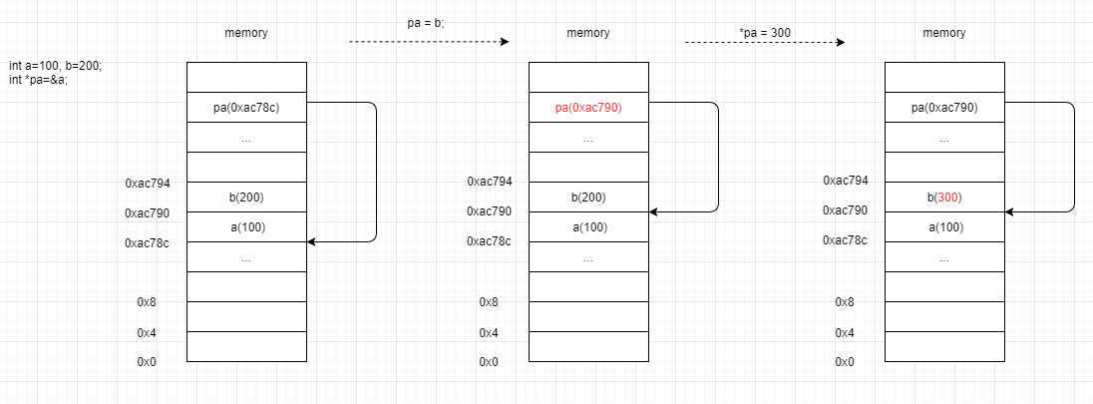
Pointer
Pointer variable
Pointer variable assignment only change the address the variable point to, assign to the dereference of the pointer changes the content stored in the memory.

Slide 15
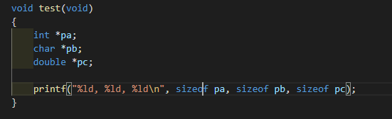
Pointer
Pointer calculation
Pointer size has no relationship with its type, it is decided by your target machine, on 32 bits system, it is always 4 bytes, on 64 bits system, it is always 8 bytes.
on my 64 bits machine, output: 8, 8, 8
Notes:
Interact with students, can anybody tell why the size is confirmed?

Slide 16
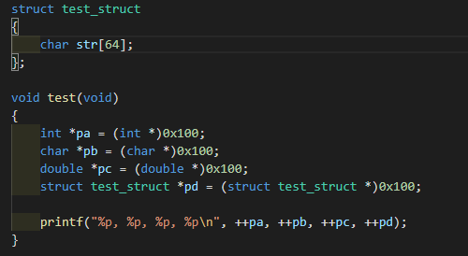
Pointer
Pointer calculation
Pointer variable can be calculated with plus, minus, self plus, self minus. Multiplying or dividing is of nonsense.
The type of pointer variable decides the step length when calculate.
output: 0x104, 0x101, 0x108, 0x140
Simply speaking, type *pa; “pa + n” results to p + n*(sizeof type) in math.
Notes:
Interact with students, Why void* can not be used to do math calculation

Slide 17
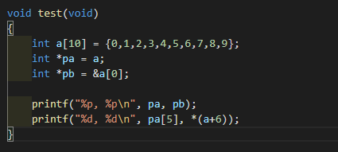
Pointer
Pointer and array
Array name is the address of the first element, so we can treat array name as a pointer, the same time, pointer can be used as array.
output: 0x7ffd558bdf30, 0x7ffd558bdf30
5, 6

Slide 18
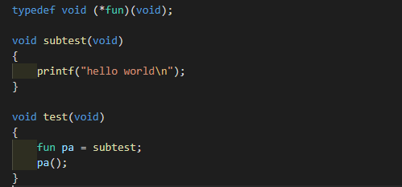
Pointer
Pointer and function
Function pointer is used to point to a function, meanwhile function name is a variable point to the address of the function, so it can be assigned to a function pointer.
output: hello world

Slide 19
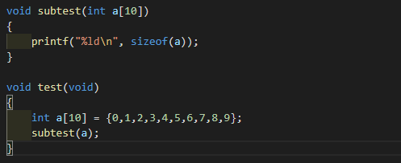
Pointer
Pointer and function
Function address is probably not continuous, so function pointer is usually not used to do math calculation in C language.
Pointer can be a parameter passed to a function or be the value returned from a function.
Pass an array to a function, the array parameter will degrade to an pointer, sizeof won’t result as expectation.
output: 8 (tip: a compile warning well be generated)

Slide 20
Structure
Definition
Storage and Size
Initialization
Access to member

Slide 21
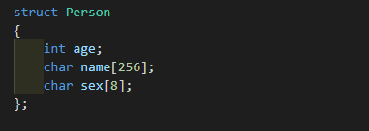
Structure
Definition
What is structure?
Structure is a set of multiple variable of different type or same type but with different meaning
Structure is defined by key word struct, it has 3 critical factor:
Key word struct
Member list
Structure name
Structure member can be of any type, even another structure.

Slide 22
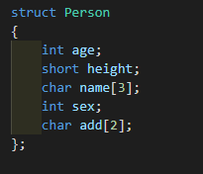
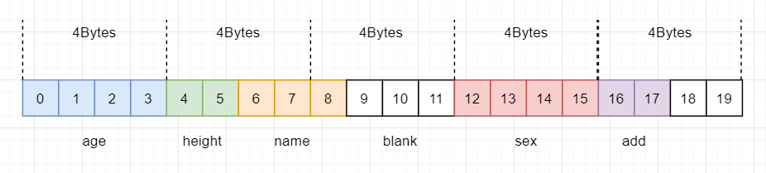
Structure
Storage
Each member of structure stores continuously together, but not byte to byte, each basic type member has to aligned to default alignment size which is decided by compiler, for gcc, default alignment size is 4 bytes.
Use sizeof to get the structure size
In this case, the size aligned to 4 bytes, so sizeof (struct Person) results 20

Slide 23
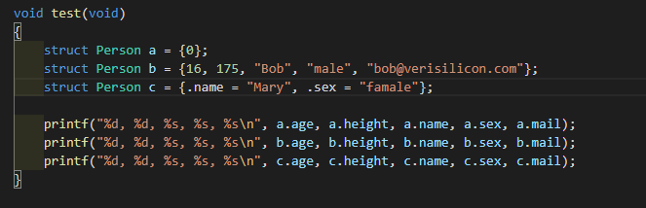
Structure
Initialization
Similar to array, structure variable has three initialization methods.
output: 0, 0, , ,
16, 175, Bob, male, bob@verisilicon.com
0, 0, Mary, famale,

Slide 24
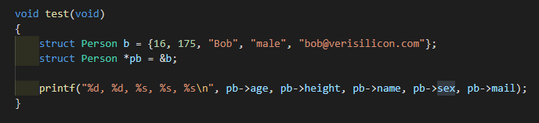
Structure
Access to member
For structure variable, use “.” to access member
For structure pointer variable, use “->” to access member
output: 16, 175, Bob, male, bob@verisilicon.com

Slide 25
Stack and Heap
Difference
Stack is usually small, too much temporary variable may cause stack flow, but heap is much bigger
Memory on stack never leak, but memory on heap may leak if programmer forget to free.
Stand on data structure, the address of memory on stack grows from high to low, but on heap, the address was managed by memory management unit, there is no regular pattern.

Slide 26
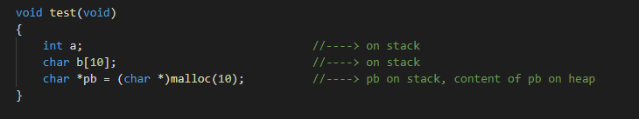
Stack and Heap
What is stack?
Stack is a range of memory used for temporary variable storage, variables on stack is managed by CPU, programmer do not need to concern it’s allocation and release.
What is Heap?
Heap is a range of memory used for dynamic variables storage, variables on heap is managed by programmer, programmer must allocate and free them manually.

Slide 27
Questions?

